Slide 1

Going Viral: What Drives a Song's Streaming Success?
Introduction to Data Science, May 2025
Presented by Group 20
Presented to Dr. Nahla Barakat

Slide 2
Project Overview & Goals
Dataset Details
Research Questions (Following Slides)
4,600 Spotify top songs from 2024, sourced via Kaggle.
Does TikTok virality boost Spotify streams?
Dataset Columns
Do more playlist features mean more streams?
Track Metadata (title, artist, album, release date, ISRC)
Do collaborations stream better than solo tracks?
Streaming Metrics (views, likes, posts, streams across 6+ platforms)
Can Shazam counts predict future streaming success?
Is there a link between radio spins and streaming numbers?
Playlist Stats (count & reach on Spotify, YouTube, Deezer, etc.)
Does release year affect total streaming performance?
Engagement (TikTok virality, Shazam counts, radio spins)
How do Spotify streams compare to YouTube views?
Popularity Scores (Spotify, TIDAL)
Do explicit songs perform better than clean ones?
Explicit Flag (clean vs explicit)
What drives a song’s all-time rank?
Do explicit songs get more TikTok love but less radio play?
Goals
To analyze and identify patterns of streaming data across platforms and uncover the main factors that drive a song’s success through data exploration and testing to understand what makes a track go viral.

Slide 3

Data Preparation Steps
1
Data Cleaning
2
Data Refinement
Handled missing data, removed nulls, and fixed number formats
Removed duplicates, whitespaces, and irrelevant columns
3
Convert Data Types
4
New Columns
Converted explicit flags and formatted dates uniformly
Created a spotify_popularity_level columns with 4 engagement tiers
5
Outlier Handling
6
Export & Structure
Checked boxplots for extreme values and handle them accordingly
Reordered columns by logic and exported the cleaned dataset

Slide 4
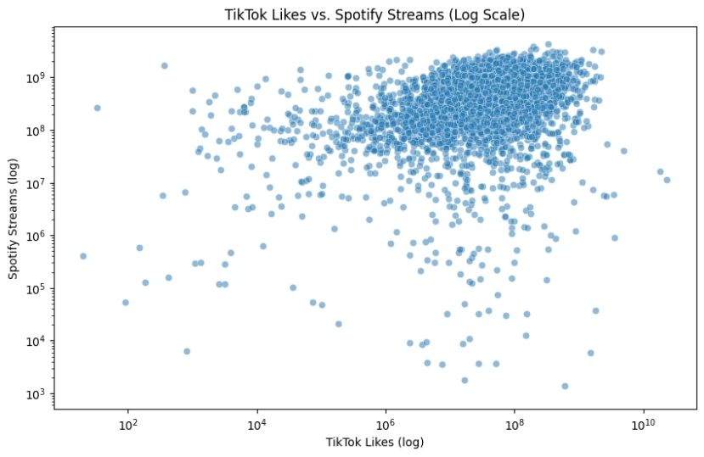
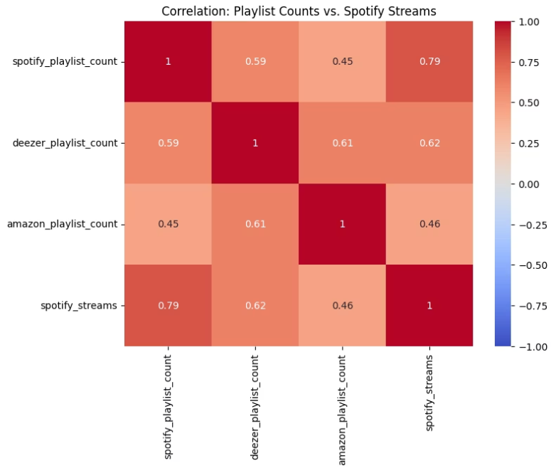
Research Questions Analysis Q1 & Q2
Does TikTok virality boost Spotify streams?
Do more playlist features mean more streams?

Slide 5
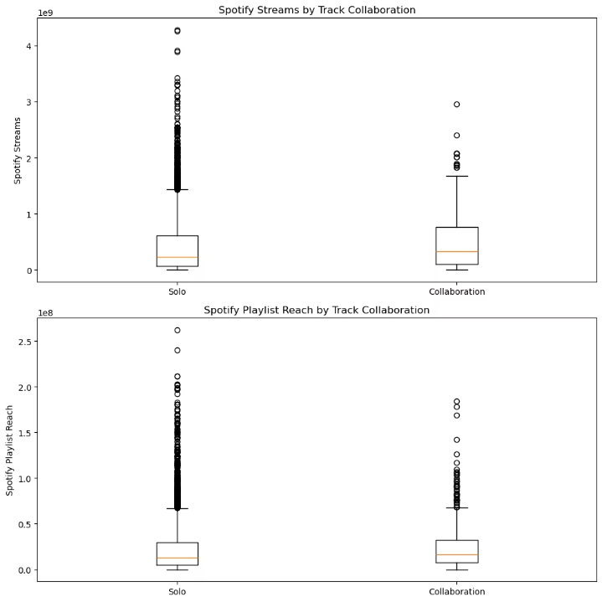
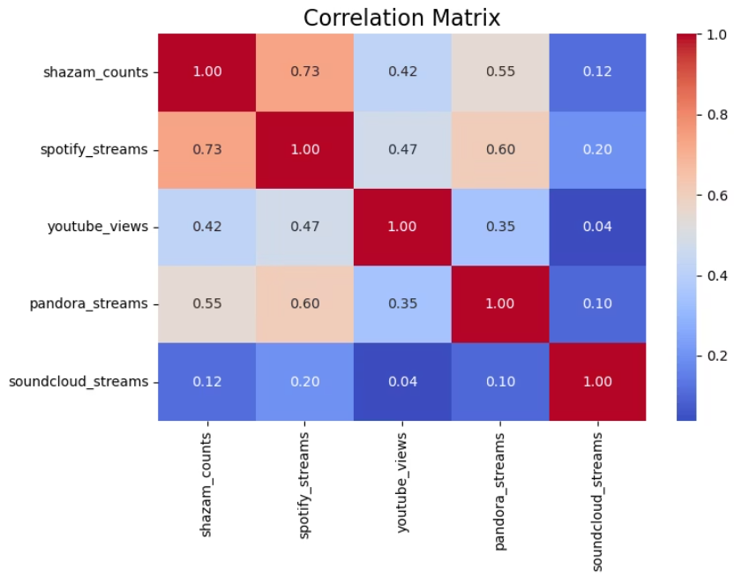
Research Questions Analysis Q3 & Q4
Do collaborations stream better than solo tracks?
Can Shazam counts predict future streaming success

Slide 6
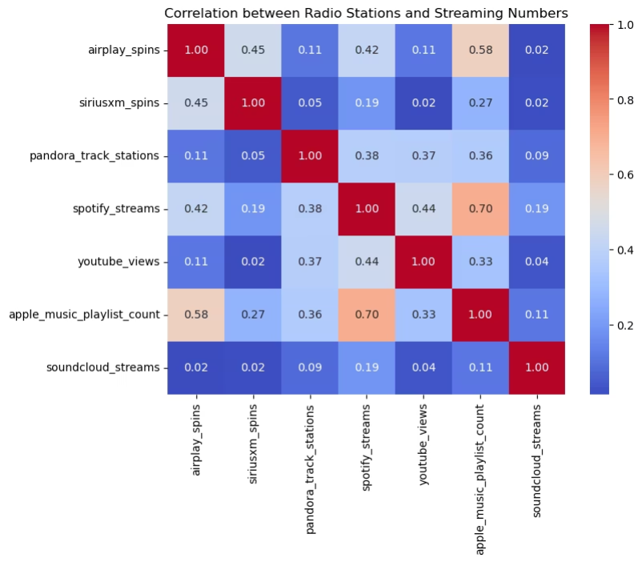
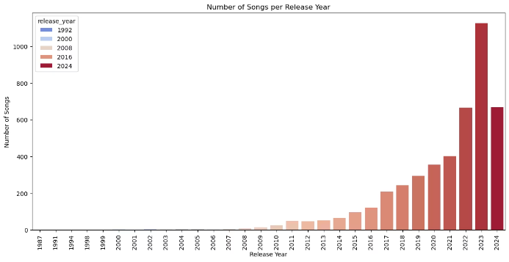
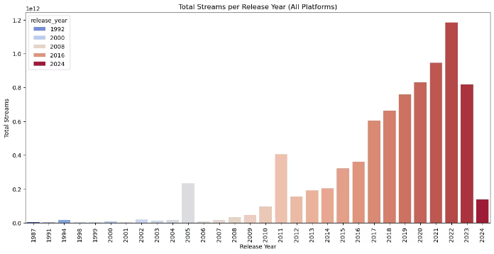
Research Questions Analysis Q5 & Q6
Is there a link between radio spins and streaming numbers?
Does release year affect total streaming performance?

Slide 7
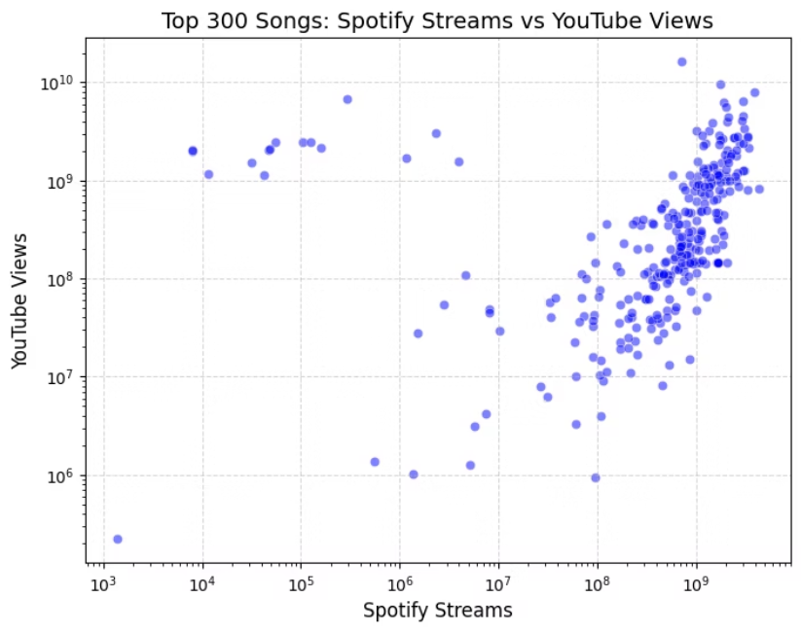
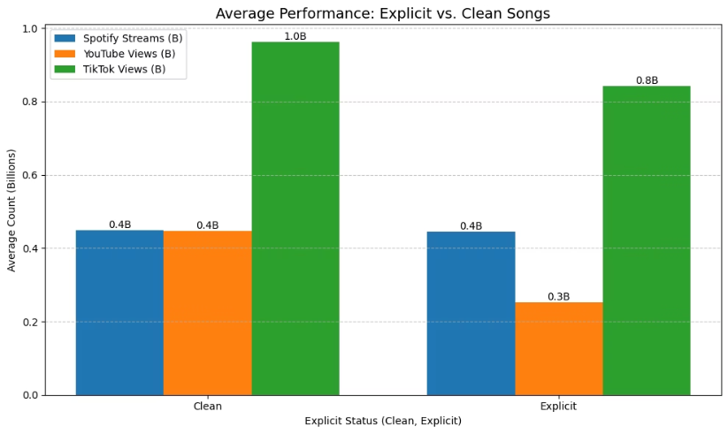
Research Questions Analysis Q7 & Q8
How do Spotify streams compare to YouTube views?
Do explicit songs perform better than clean ones?

Slide 8
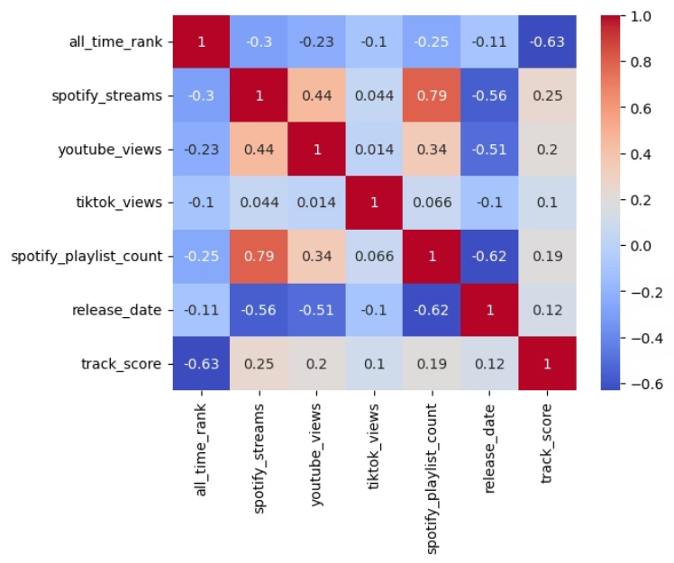
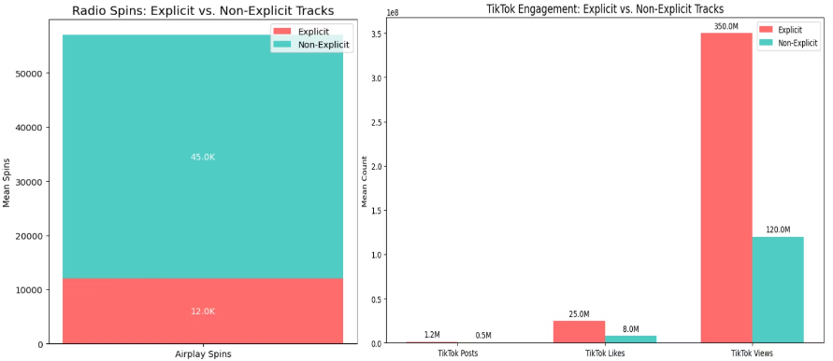
Research Questions Analysis Q9 & Q10
What drives a song’s all-time rank?
Do explicit songs get more TikTok love but less radio play?

Slide 9

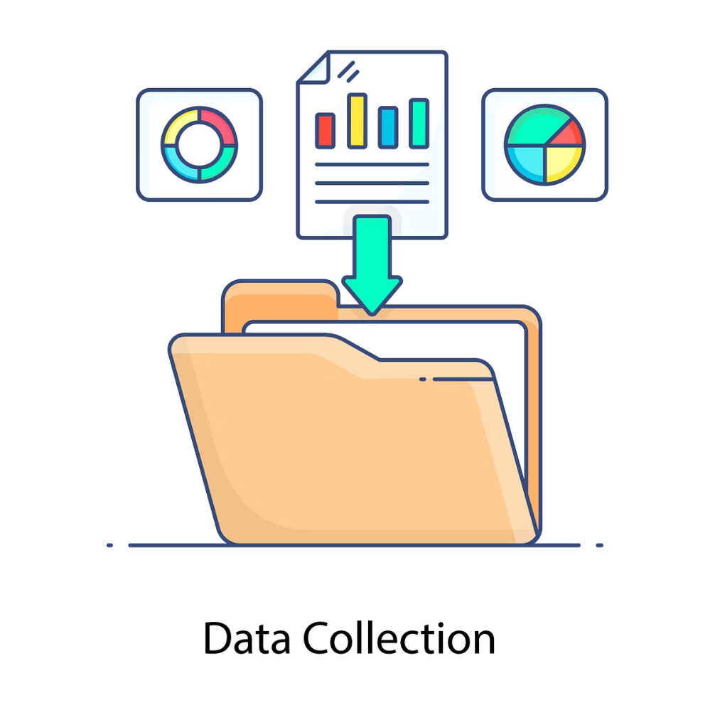
New Data Collection
Data Scrapping
Searching for extra data from online HTML websites
Expanded Dataset
Extracted extra information like daily listens, 2025 streams, and genres
Scraping Tools
Used requests, BeautifulSoup, and pandas to extract the data

Slide 10

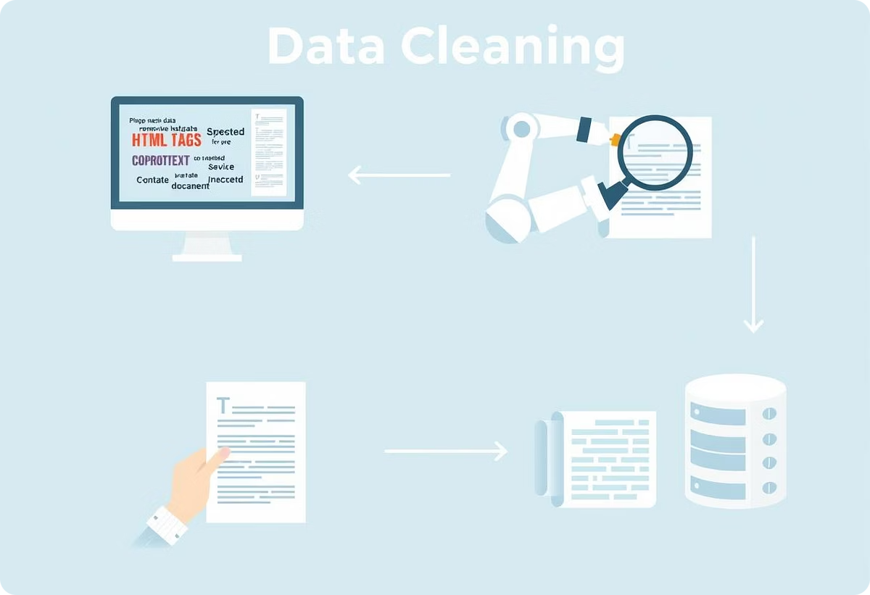
Cleaning Scraped Data
1
Data Cleaning
Handled missing data, removed nulls, and negative values
2
Data Refinement
Handled inconsistent formatting and removed duplicates, whitespaces, and irrelevant columns
3
Converted Data Types
Converted columns to their proper datatype

Slide 11


Merging All Data
1
Merge Keys
2
Mismatch Handling
Joined datasets using Track column.
Drop duplicate songs, null values, and remove redundant columns
3
Matching Rate
4
Data Loss
Achieved 43% successful merge with 1,062 valid records.
Major loss due to unmatched entries.

Slide 12
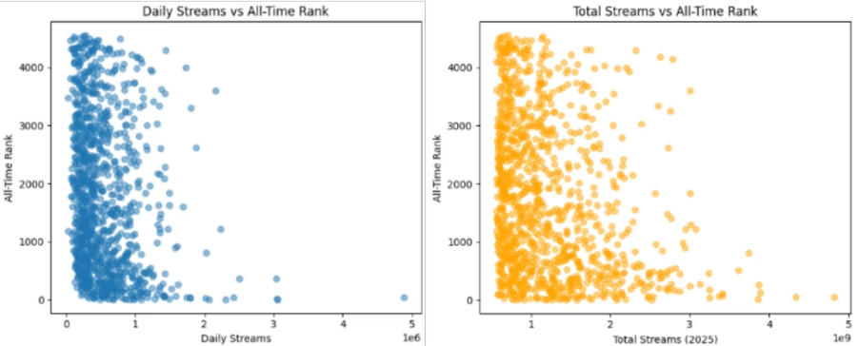
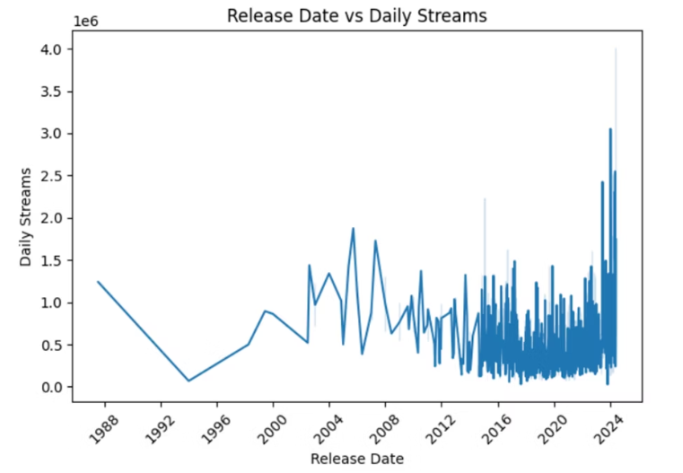
Research Questions Analysis Q11 & Q12
Question
Question
Do daily streams better predict all-time rank than total streams?
Do recent tracks get more daily streams (recency effect)?
Insight
Insight
Daily streams are a stronger and more relevant predictor of a song’s current rank than total historical streams.
It’s clear that newer tracks tend to receive more daily streams, reflecting a dynamic and fast-moving listening culture.

Slide 13
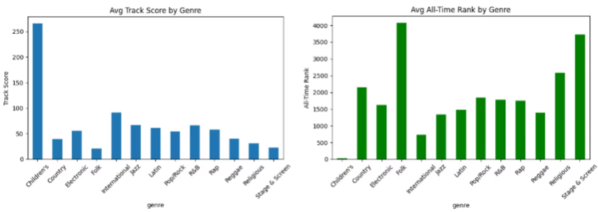
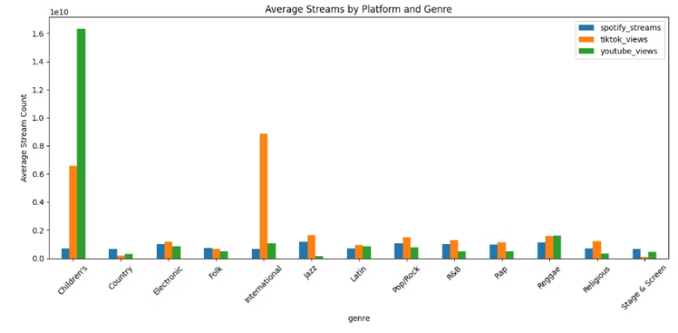
Research Questions Analysis Q13 & Q14
Question
Question
Are some genres more associated with high all-time rank or track score?
Do different genres dominate different platforms (Spotify, TikTok, YouTube)?
Insight
Insight
Genre plays a significant role in streaming success metrics, with mainstream or functional genres performing better in both ranking and scoring systems.
Platform dynamics matter: Genre success is platform-dependent, and artists may benefit by targeting the platform where their genre performs best.

Slide 14

Hypothesis Testing Using Chi-Square Test
1
Question
Is there a relationship between a song being explicit and its Spotify popularity level?
2
Hypothesis assumptions
H₀: Spotify popularity and explicit content are independent H₁: Spotify popularity and explicit content are dependent Significance level: 5%
3
Final Result
Freedom = 9 and Chi score = 12.288 and Tabular value = 16.919 Since the Chi value is less than the Tabular value, we accept the null hypothesis
4
Conclusion
There is no significant relationship between Spotify popularity and whether a song is explicit or not

Slide 15

Thank you
Q&A?

